Slide 1
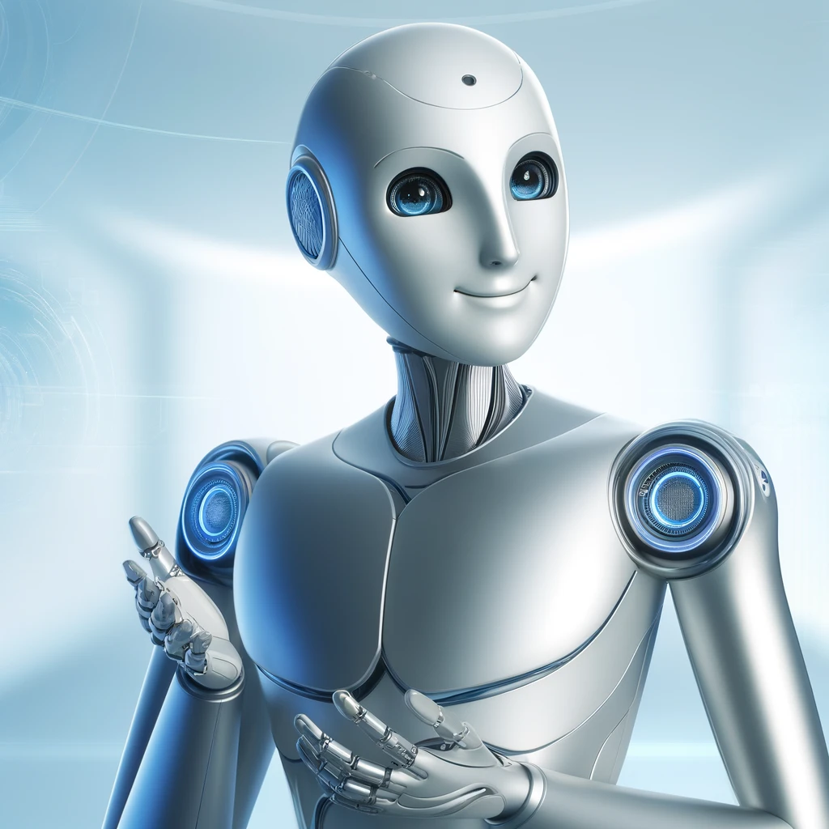
Artificial Intelligence for non-technical professionals

Slide 2




Notes:
https://www.youtube.com/channel/UC35ZpwldGw7ZJ5R-2sLijzw

Slide 3
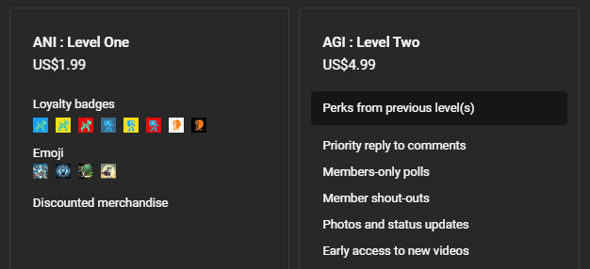

Membership has its privileges
Notes:
https://www.youtube.com/channel/UC35ZpwldGw7ZJ5R-2sLijzw/join

Slide 4
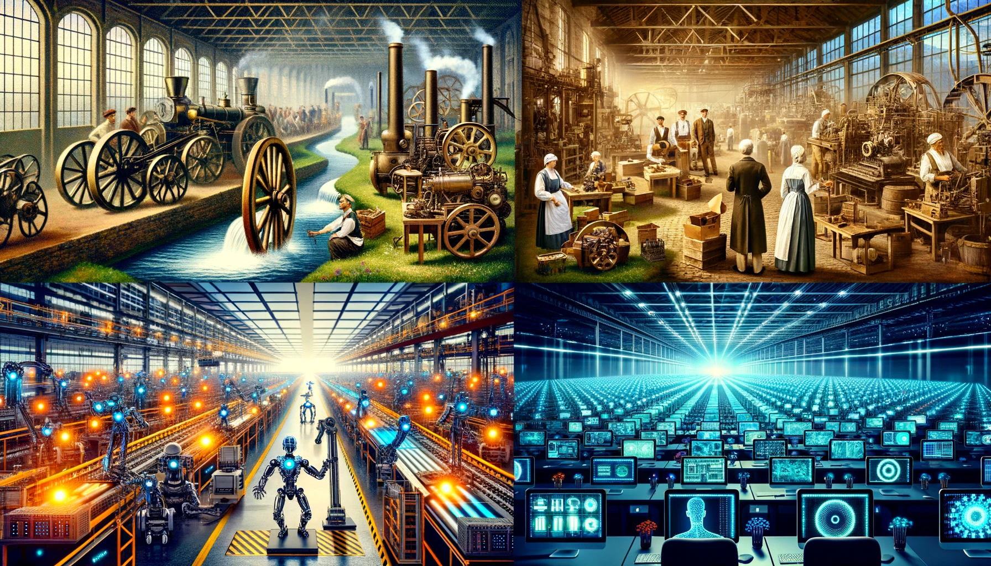
1.0 Mechanization, Steam, and Water Power
2.0 Mass Production and Electricity
3.0 Electronic / IT Systems and Automation
4.0 Cyber Physical Systems and
Artificial Intelligence
Notes:
https://www.forbes.com/sites/forbescoachescouncil/2023/10/30/generative-agile-leadership-what-the-fourth-industrial-revolution-needs/

Slide 5
What is Artificial intelligence?
Artificial Intelligence, or AI, is technology that allows machines to learn from information and act like humans, doing things like making decisions and understanding speech without needing step-by-step instructions.

Slide 6
Originated in the mid-1950’s
Blanket term for all intelligent computing
Goal is to simulate human intelligence
Early forms of this were simple If…Then statements
Medical: Use a set of rules to determine diagnosis
Artificial Intelligence (AI)
Machine Learning (ML)
Deep Learning (DL)
Originated in the 1960’s
Goal is to get machines to learn from and make decisions based on data without a lot of rules
Machines learn through data patterns to solve problems
Weather: Uses machine learning to take in weather data and make a prediction about future weather
Originated in the 1980’s
Goal is to learn from lots of sample data so it can recognize pictures, words, or sounds by itself
Phone: Facial recognition on your phone uses deep learning to recognize you

Slide 7
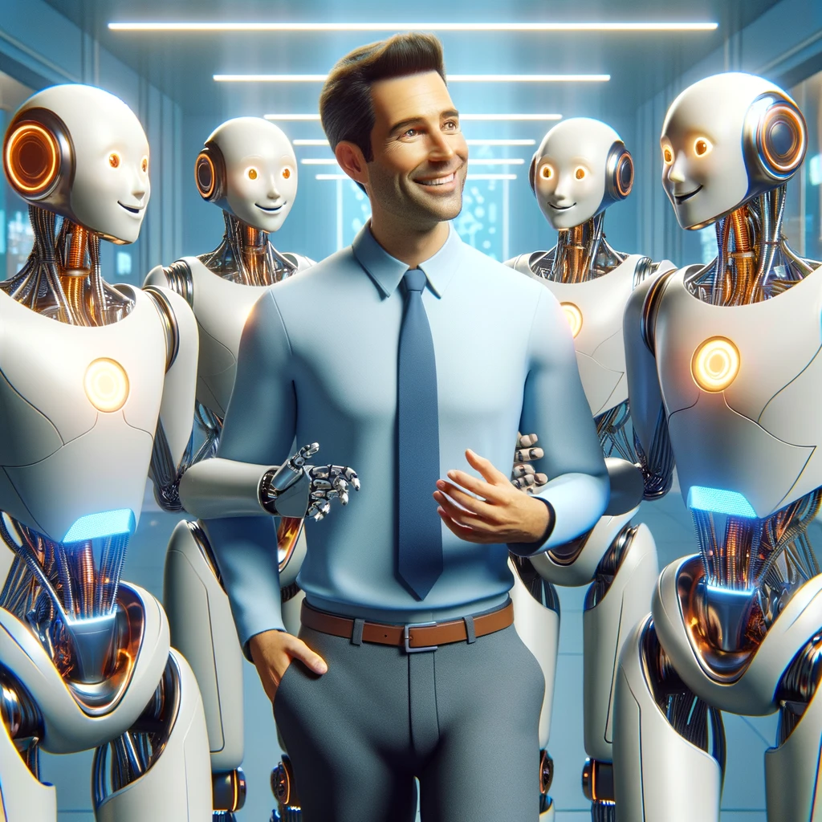
AI is already all around you

Slide 8
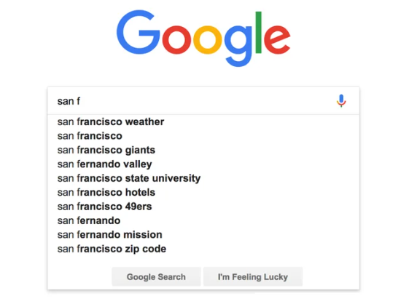

Slide 9

ML: Prediction
When you start typing a search term into Google, it uses a type of AI to predict what you might be looking for based on the first few letters you type. This AI looks at what lots of other people have searched for that starts with the same letters and suggests the most common searches to you. This helps you find what you need faster, even if you're not sure how to spell it or exactly what to search for.

Slide 10
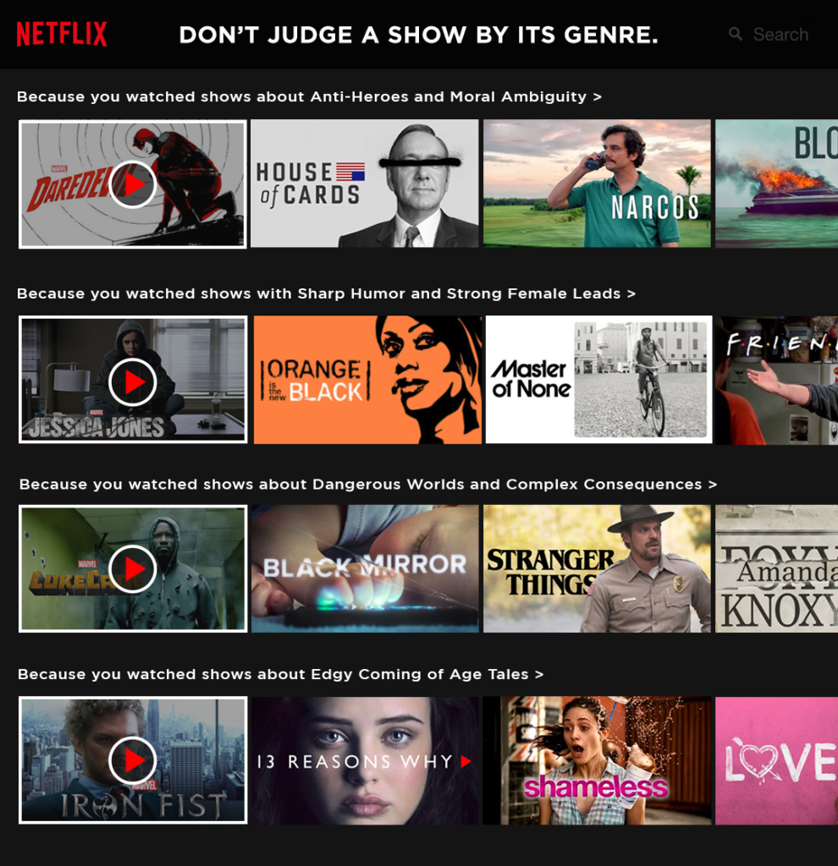

Slide 11

ML: Prediction
Netflix uses AI to figure out what kinds of shows and movies you like to watch. It looks at your previous choices, what you've watched and enjoyed, and then suggests other shows and movies that are similar. This way, the more you watch, the better Netflix gets at recommending things you might like.

Slide 12
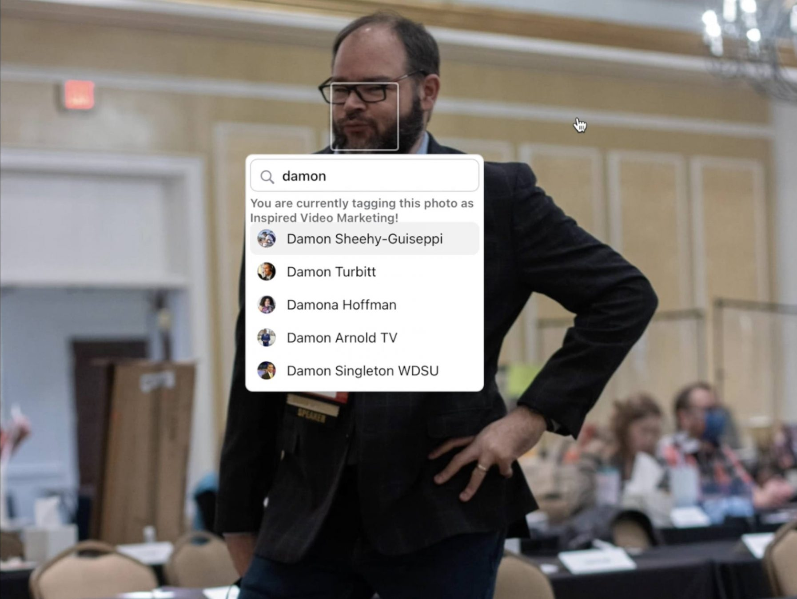

Slide 13

DL: Vision
When you upload a photo on Facebook, it uses AI to look at the faces and figure out who might be in the picture. It compares these faces to others it has seen in past photos to see if they match anyone you know. This helps Facebook suggest who you might want to tag in your photos, getting better at recognizing your friends the more you tag them.

Slide 14
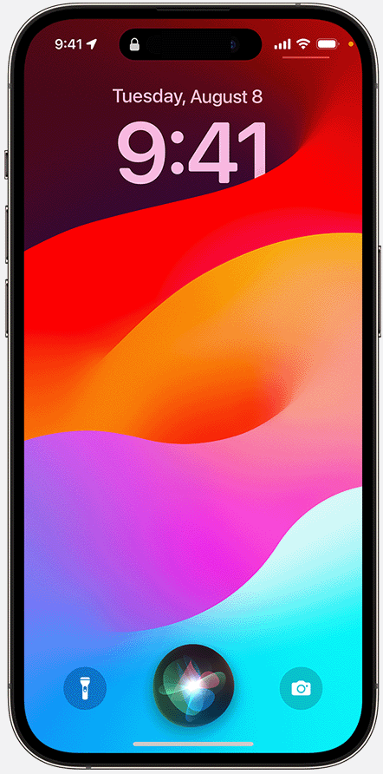

Slide 15

DL: Speech
Siri is a smart assistant on Apple devices that you can talk to just like you would to a person. When you ask Siri a question or tell it to do something, like set an alarm or send a message, it uses a special kind of technology called deep learning to understand your voice and figure out what you mean. Then, Siri quickly responds or does the task you asked for, making it easier to use your device without having to type or tap.

Slide 16
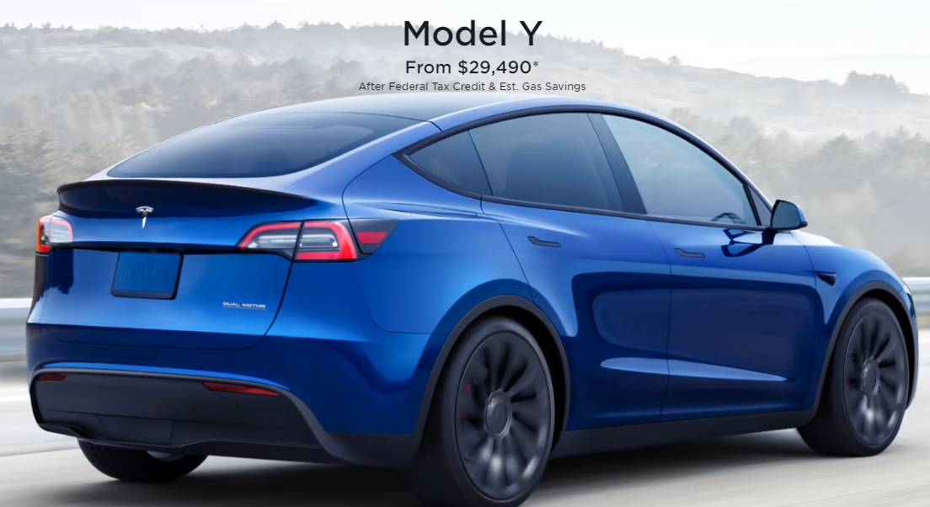

Slide 17

DL: vision
Tesla's self-driving cars use a special method called supervised learning to help the car understand what it sees on the road. It's like learning from flashcards; the car's AI system is shown lots of pictures where things like cars, people, and street signs are marked. This way, the car learns to recognize these things by itself when it's driving, helping it make smart decisions about where to go and what to do.

Slide 18
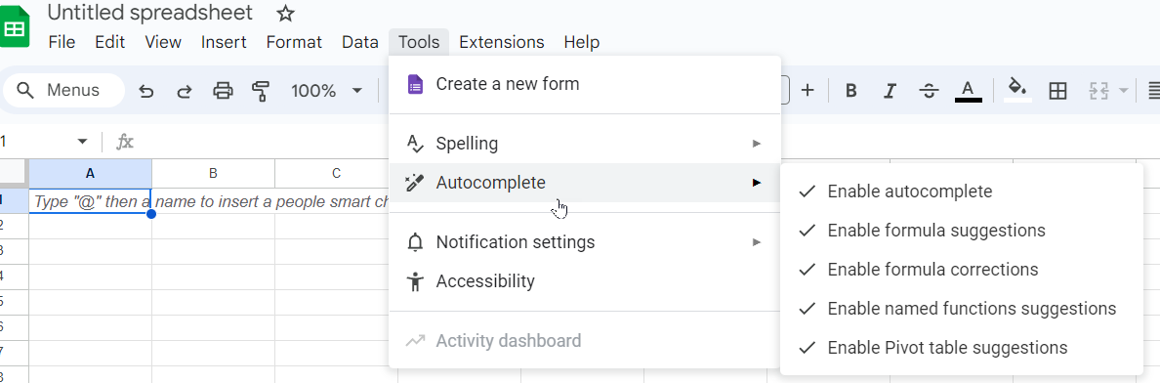

Slide 19
ML: Prediction
In Google Sheets, the autocomplete feature is designed to enhance your efficiency by predicting and suggesting text based on the content you start entering in a cell. When you type "@" followed by characters, Google Sheets begins to suggest relevant content, such as names of people or items that have been mentioned or used in your spreadsheet or connected Google services. This feature is part of Google’s smart fill capabilities, which use a form of AI to recognize patterns or common entries. It not only speeds up data entry but also helps reduce errors by suggesting accurate completions based on existing information. This is especially useful in large data sets or when you are collaborating with others, as it ensures consistency in the data entered.

Slide 20
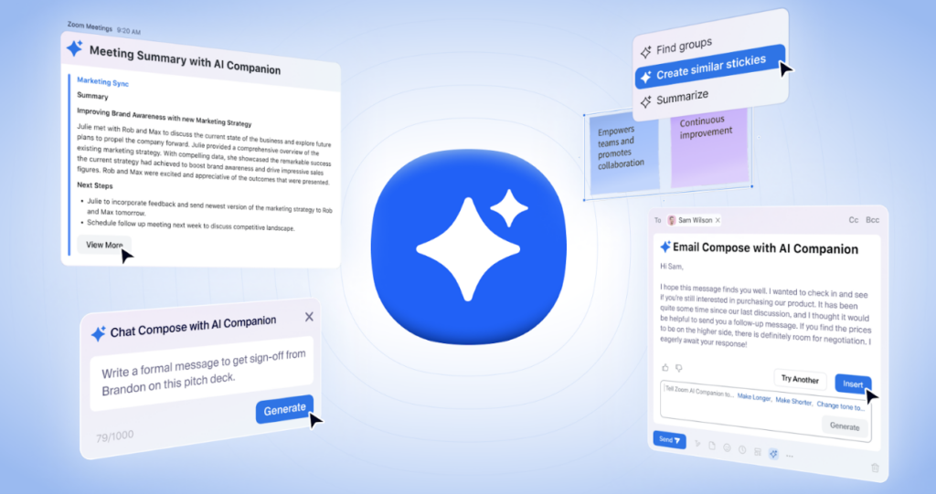
Zoom ai companion

Slide 21
DL: Generative text
The Zoom AI Companion enhances productivity and communication in virtual meetings by intelligently automating several aspects of the meeting process. For instance, it automatically generates a detailed summary of your discussions, capturing key points and action items, which helps in maintaining continuity and clarity post-meeting. The AI also assists in composing messages and emails by suggesting contextually appropriate content based on the discussion, thus streamlining follow-ups. This not only saves time but also ensures that communications are consistent and aligned with the meeting's outcomes.

